Slide 1
Using Church Records for Historical and Genealogical Research
Christopher H. Owen
Professor of History, Northeastern State University

Slide 2
Protestant Denominational Tree

Slide 3
First Amendment to the United States Constitution
Congress shall make no law respecting an establishment of religion, or prohibiting the free exercise thereof; or abridging the freedom of speech, or of the press; or the right of the people peaceably to assemble, and to petition the government for a redress of grievances.

Slide 4
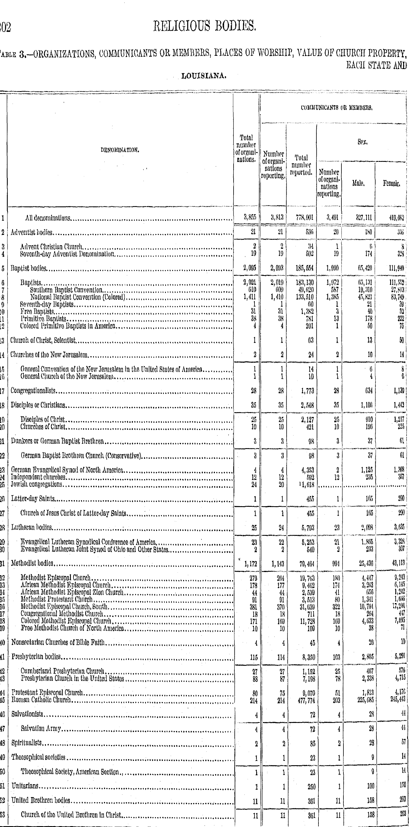

Slide 5
Mt. Zion Methodist Church
Hancock County, Georgia
Built About 1817

Slide 6
Mt. Zion Methodist Church
Hancock County, Georgia
Interior

Slide 7
Benajah D. Owen Tombstone
Bellwood Baptist Cemetery
Natchitoches Parish
Louisiania

Slide 8
Bellwood Baptist Church Today

