Slide 1
Family History

Slide 3
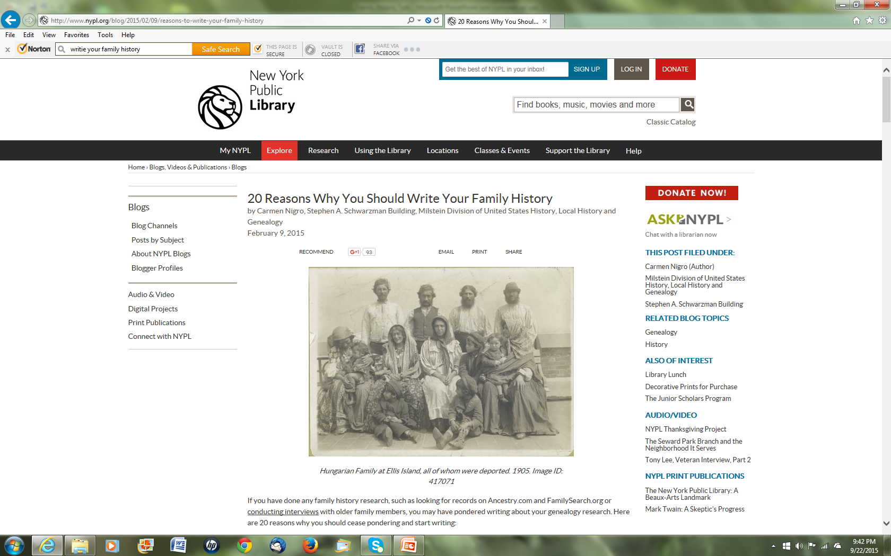

Slide 4
20 Reasons
You’ll feel wiser.
First person narratives and family histories are important historical documents.
You are an important person. You have things to pass on, to your children, to your local history society, to unknown future generations.
You and your family are important to somebody, probably many somebodies.

Slide 5
Family trees are abstract. Stories add depth.
Memories over time become fragmented and distorted. People may not remember the things you told them but did not write down.
Writing your family history gives you the chance to depict your ancestors how you see fit.
There is a need for diverse family histories about those who have not been represented well in history texts.

Slide 6
There is a need for more family histories documenting female lines.
There is a need for more family histories about families who are not affluent.
Family histories humanize the people you know or knew and remember for those who did not know them.
Information raises questions. Genealogy research has brought new facts into your life.

Slide 7
It may help you understand your current family dynamics.
It will help you build or solidify a sense of family.
Writing is reflective. Writing is investing in yourself.
It can be therapeutic.
Don’t take for granted that the lives of your ancestors are lost. Evidence of the people they have been exists somewhere and is discoverable.

Slide 8
“It will have a wider impact than you might imagine.”
Family members and even distant cousins may become more forward in contributing documents, photos, and stories for your genealogical research.
You will be encouraged to archive and preserve the documents on which your family history research is based: certificates, letters, diaries, etc.

Slide 9
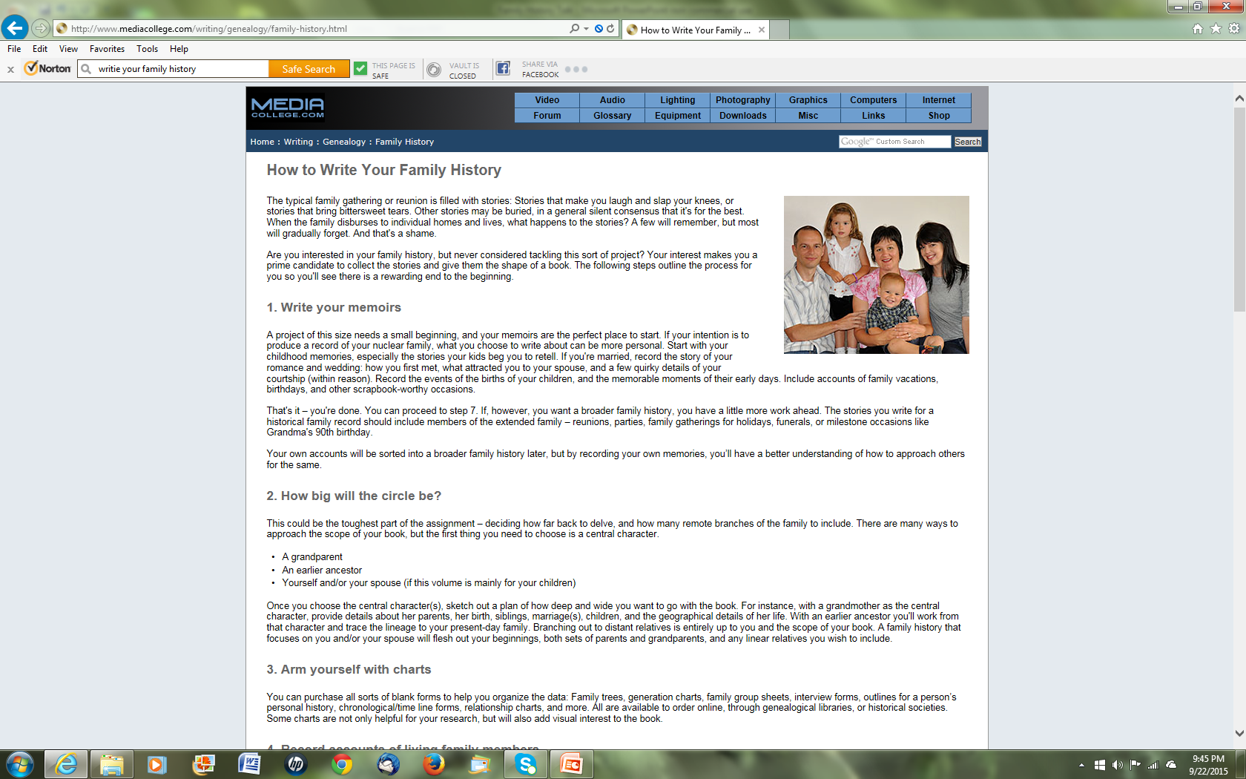

Slide 10
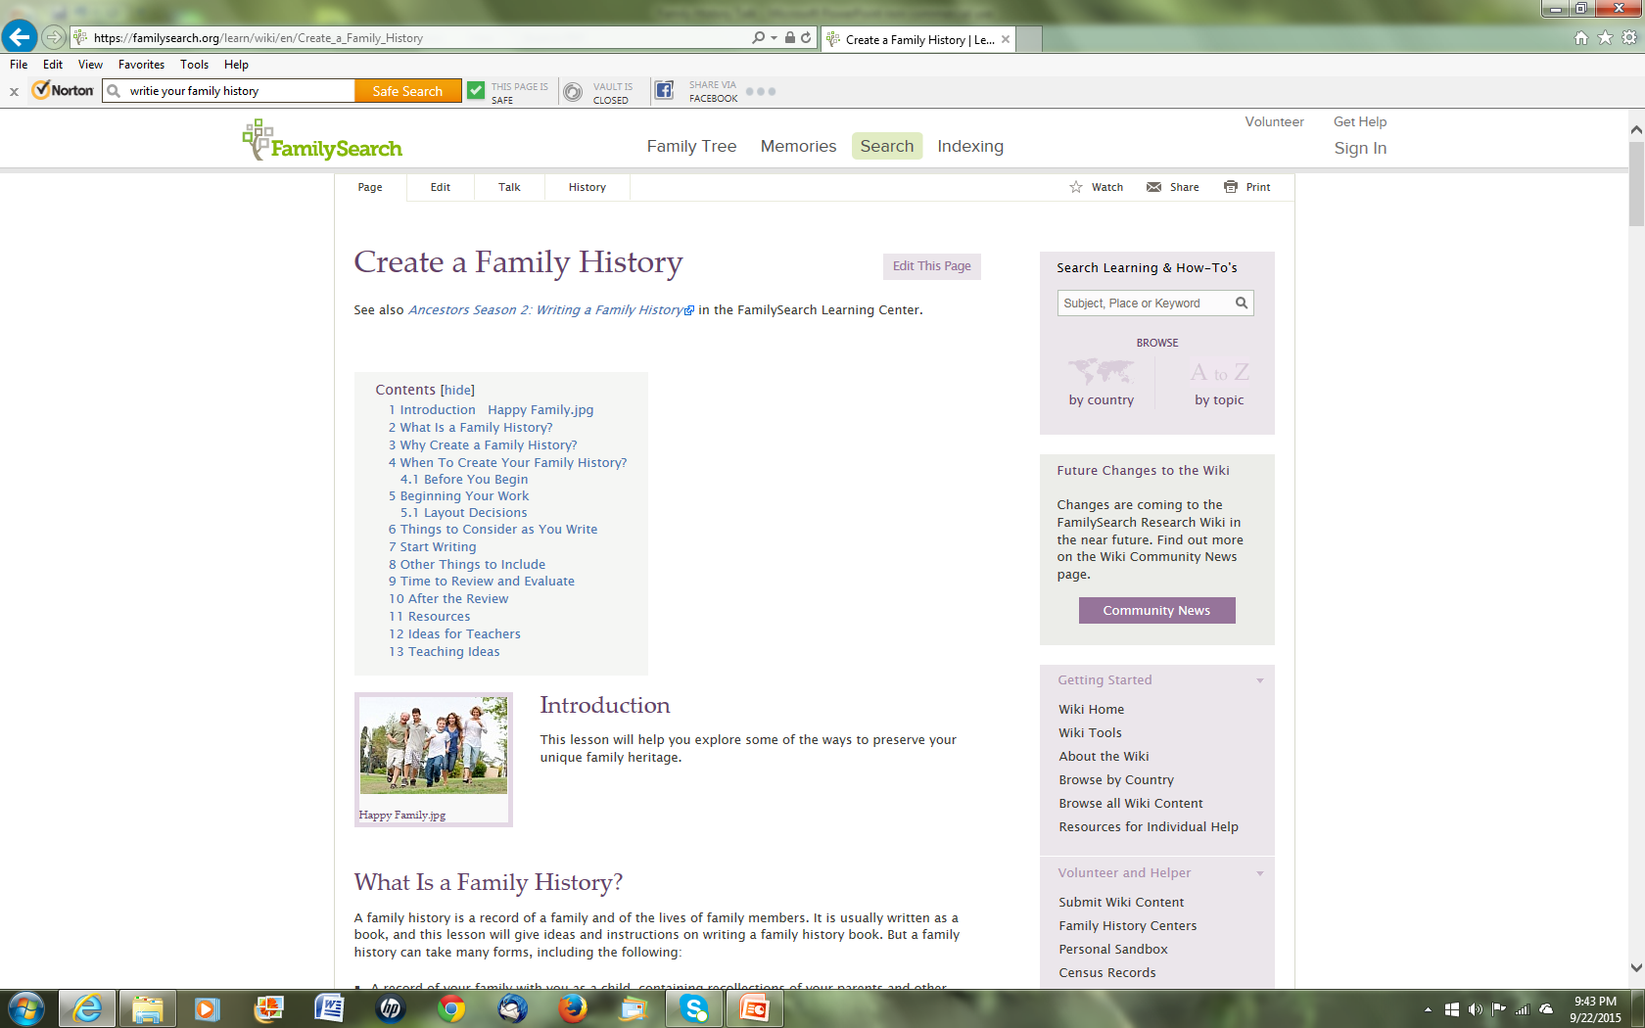

Slide 11
Tracing Your Family Tree
Gather what you already know
Talk to your relatives
Put it on paper
Focus your search
Search the web including ethnic and regional sites
Visit your local library, genealogy society, family history center
Organize

Slide 12
Write Your Memoirs
Gather information
Record events
Talk to relatives
Make list of stories

Slide 13
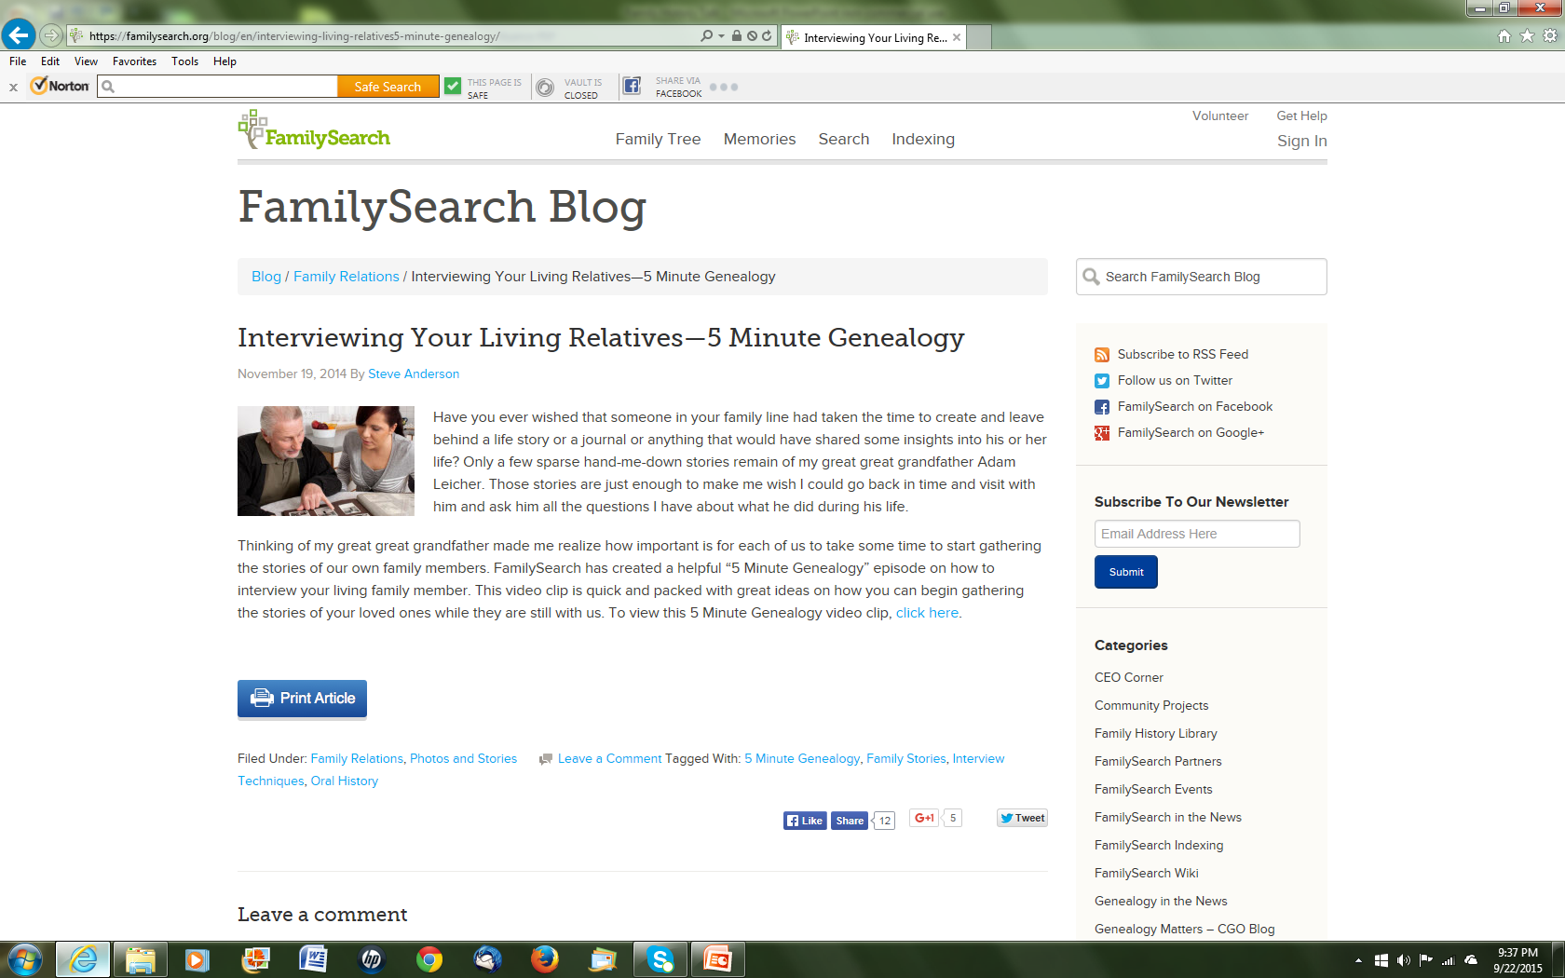

Slide 14
Family History or Genealogy of a Family
Create two sections for the book
List all the names, dates, marriages and other life events in one section
Write narrative stories for a second part

Slide 15
How big will the circle be?
Choose a central character
Area of focus - one family linage or many interconnected families, a time in history, a place

Slide 16
Arm yourself with charts
Avail yourself to the charts on the Family Tree Magazine website
Charts provide a framework for stories
A family history doesn't become a "history" without stories or other information to help our ancestors 'live' again.

Slide 17
Dig for facts
Research is required
Explore the web
Explore sources where your family lives or lived
Read history
Make copies
Keep organize

Slide 18
Order the accounts
Enter the factual information such as names and dates into forms in a genealogical software program
List all the names, dates, marriages and other life events in one section, and write narrative stories for a second part.
Plan the content of the book

Slide 19
Table of Contents
Narrative
Index –it is very important to list every person mentioned in your book and on what page or pages they appear.
Bibliography: Include the names of books or other materials that you used in your research
Documentation: list your sources of information
Appendices can be used for anything and everything. Perhaps you want to include a 'family album' of photos, cultural, ethnic, or religious information, pedigree charts, scans or photo copies of interesting documents, passenger lists, etc.

Slide 20
Add narration
Every book and chapter needs an introduction, middle, and end
Fill in the blanks
Add background information on the time period your ancestor lives
Use creative storytelling techniques to write compelling tales

Slide 21
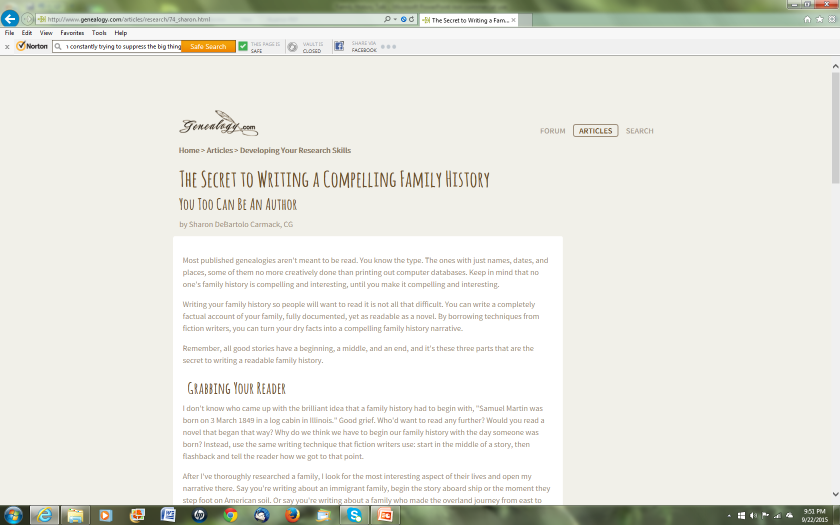

Slide 22
Grab your reader - get the attention of family members who normally don't read history
You don’t have to begin with a birth – open your narrative with the most interesting aspect of their lives

Slide 23
Hannah Martin was senile. In 1904, Hannah was eighty-two-years-old and since 1879, living off of her third husband's Civil War pension. Nervous, agitated, and afraid of loosing her one means of support, Hannah had mislaid or lost her pension certificate and could not find it anywhere. Without it, the pension agent in Indianapolis could stop her payments. Fortunately, Walter Hughes, the resident agent for the Phoenix Insurance Company, came to her rescue. Hughes reassured Hannah that he would handle the problem and wrote the pension office on her behalf.

Slide 24
Fill in the background or use flashbacks
Keeping the story from sagging in the middle - create an air of mystery

Slide 25
I thought I could see the thing through, Grace, but I was a fool to think so. It's no go. The last few months have been pure hell, and I don't have to tell you to what silly, foolish little things I stooped in constantly trying to suppress the big thing, which I considered I had no right to say…. I've got to know whether I have a chance. As you probably know, I haven't anything to offer you; to ask you to marry me at present would be no compliment…. But if I'm ever lucky enough to be able to ask you with a clear conscience, will I have a chance? Will you write real soon and tell me, and tell me in words of one syllable, because nothing could be worse than uncertainty.
I'm not saying the things that are usually said and that I want to say so badly, because I want to keep this letter as rational as possible, and I'm sure you know them anyway. But if I get a certain answer, oh what a letter I will write! Will you send it right away, you wonderful girl?

Slide 26
Would you want to look at the next page?

Slide 27
End the story
End with a wedding, birth of the next generation, birthday party for your central character, reflections
You do not have to kill off the older generation to end the story
The secret to writing a compelling family history is crafting your facts into a nonfiction narrative, using fiction techniques

Slide 28
Rewrite
Review
Check facts
Check name spelling

Slide 29
Format the text
Ease of reading
Remember your audience when formating

Slide 30
Edit
Edit your work to prevent future embarrassment
Expect to spend at least as much time editing as you did writing

Slide 31
Add photographs
Take pictures
Use pictures
Use charts
Use maps
Properly store original photographs
Organize

Slide 32
Publish
Print or digital
The appearance and quality of the finished book will depend on your budget
In the end, you'll hold in your hands what could become your family's most treasured possession

